Slide 1
Serverless Architecture
Pravin Y Pawar

Slide 2
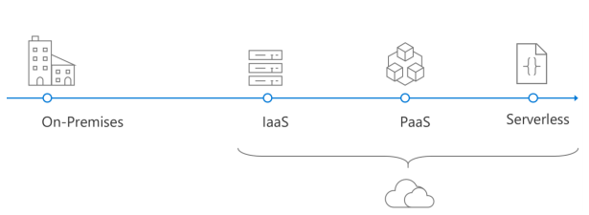
Evolution of cloud platforms
Serverless is the culmination of several iterations of cloud platforms
The evolution began with physical metal in the data center and progressed through Infrastructure as a Service (IaaS) and Platform as a Service (PaaS)

Slide 3
Going Serverless
Serverless
Is the evolution of cloud platforms in the direction of pure cloud native code
Brings developers closer to business logic while insulating them from infrastructure concerns
A pattern that doesn’t imply “no server” but rather, “less server”
Serverless code is event-driven
Code may be triggered by anything from a traditional HTTP web request to a timer or the result of uploading a file
The infrastructure behind Serverless allows for instant scale to meet elastic demands
offers micro-billing to truly “pay for what you use”
Serverless requires a new way of thinking and approach to building applications and isn’t the right solution for every problem!

Slide 4
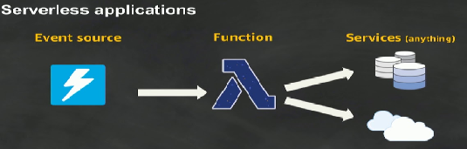
Serverless
A Serverless architecture provides a clear separation between the code and its hosting environment
You implement code in a function that is invoked by a trigger
After that function exits, all its needed resources may be freed
The trigger might be manual, a timed process, an HTTP request, or a file upload
The result of the trigger is the execution of code
Although Serverless platforms vary, most provide access to pre-defined APIs and bindings to streamline tasks such as writing to a database or queueing results
Serverless is an architecture that relies heavily on abstracting away the host environment to focus on code
Container solutions provide developers existing build scripts to publish code to Serverless-ready images
It can be thought of as less server!
source : AWS

Slide 5
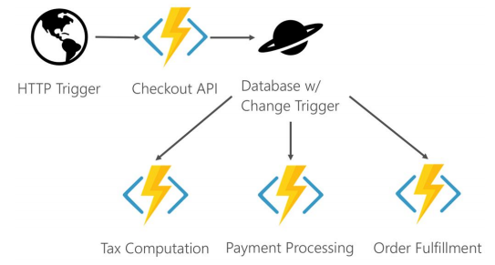
Serverless components
An HTTP request causes the Checkout API code to run
The Checkout API inserts code into a database
The insert triggers several other functions to run to perform tasks like computing tasks and fulfilling the order.
source : Microsoft

Slide 6

Advantages of Serverless
High density
Many instances of the same serverless code can run on the same host compared to containers or virtual machines
The instances scale across multiple hosts scale out and resiliency
Micro-billing
Most serverless providers bill based on serverless executions, enabling massive cost savings in certain scenarios
Instant scale
Serverless can scale to match workloads automatically and quickly
Faster time to market
Developers focus on code and deploy directly to the serverless platform
Components can be released independently of each other
source : DZone

Slide 7
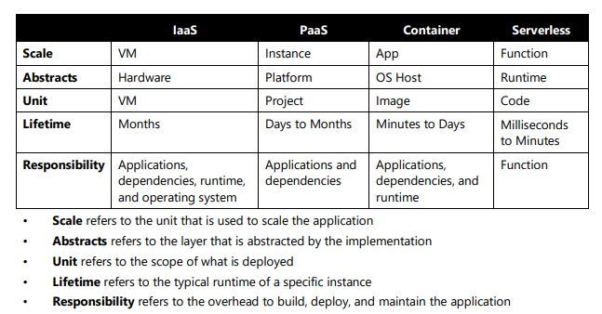
Summarized
source : Microsoft

Slide 8
Thank You!
Reference:
Serverless apps Architecture patterns and Azure implementation
By Microsoft
In our next session:

